Slide 1


NEURAL NETWORK
NIRMAL R
Deep2Neuron Internship

Slide 2
Neural Network
A neural network is a computer system inspired by the human brain that can learn and make predictions or decisions.
It consists of interconnected nodes, called neurons, organized into layers.
Each neuron takes inputs, performs a calculation, and produces an output.

Slide 3
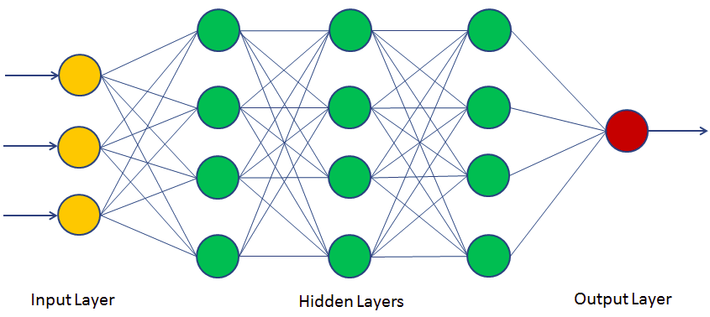
Neural Network

Slide 4
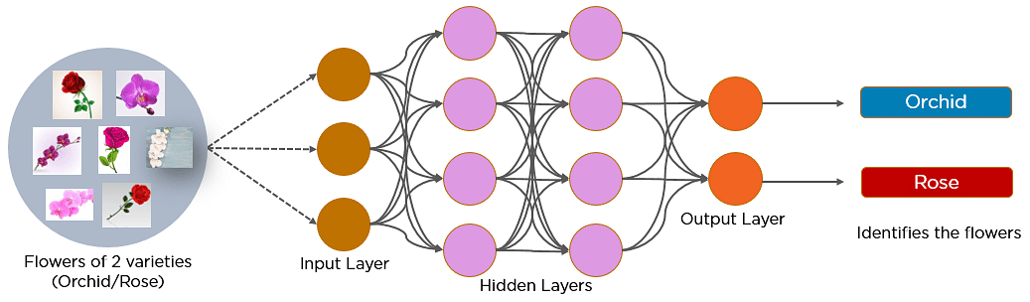
CNN

Slide 5
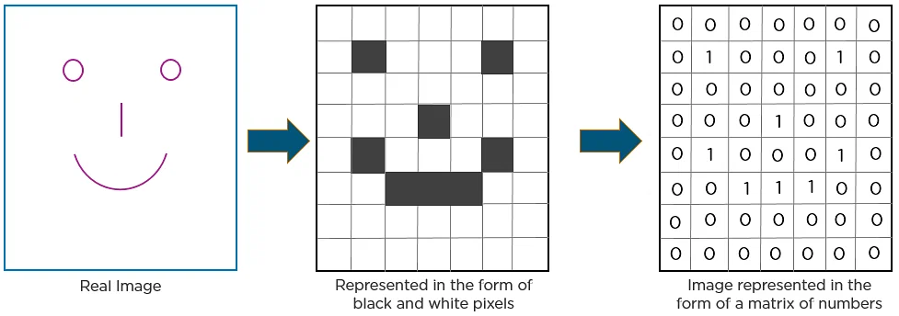
CNN recognizes an image

Slide 6
Layers of CNN
Pooling
Convolutional Layer
Fully Connected Layer

Slide 7
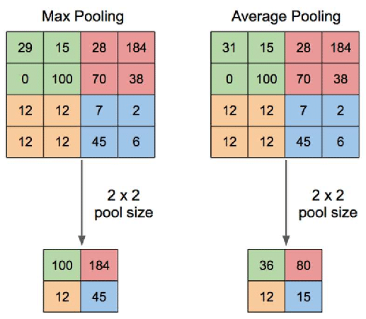
Pooling

Slide 8
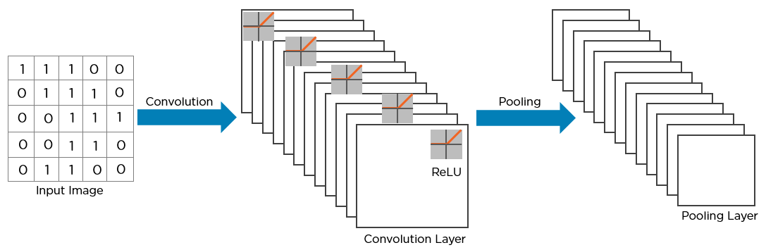
Convolutional Layer

Slide 9
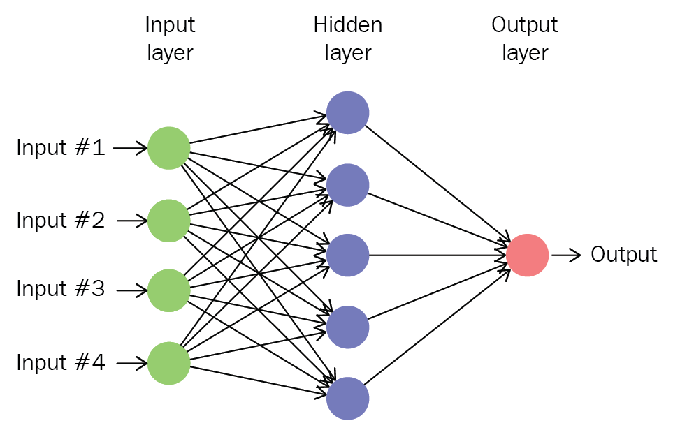
Fully Connected Layer

Slide 10
Uses of CNN
Image Classification
Object Detection
Semantic Segmentation
Art Generation and Style Transfer

Slide 11
RNN(Recurrent Neural Networks)
RNNs are neural networks that process sequential data by maintaining an internal hidden state and capturing temporal dependencies.
They are particularly useful for tasks involving time series analysis, natural language processing, and any other application where the order of the data is important.

Slide 12
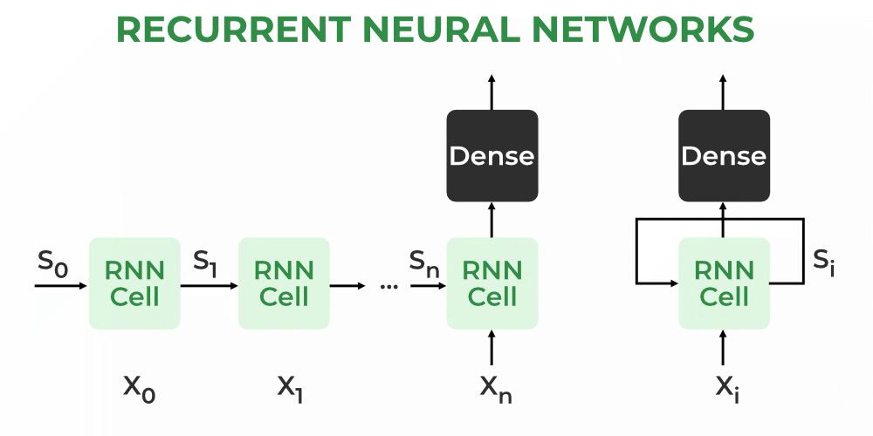
RNN

Slide 13
Types Of RNN
One to One
One to Many
Many to One
Many to Many

Slide 14
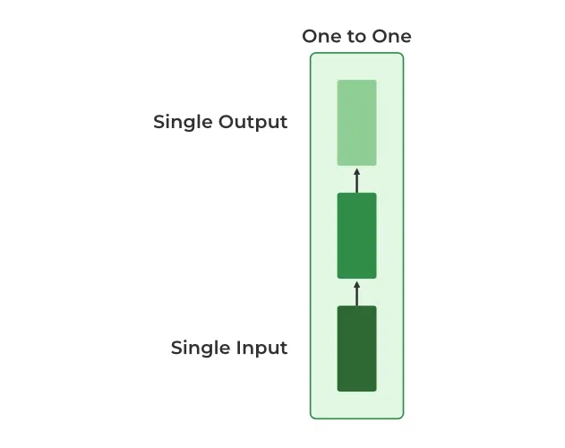
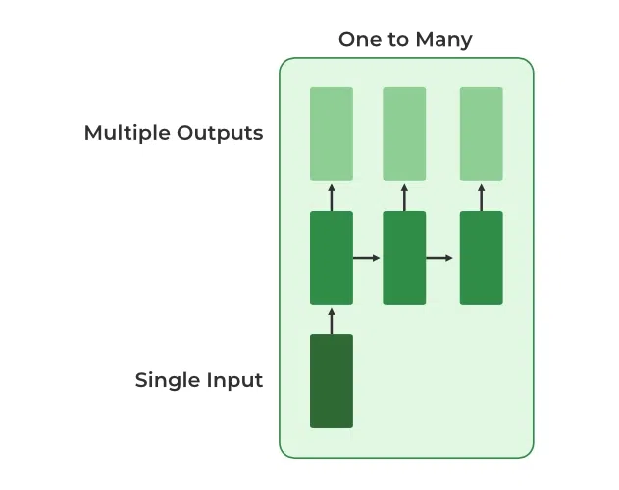
One to One
One to Many

Slide 15
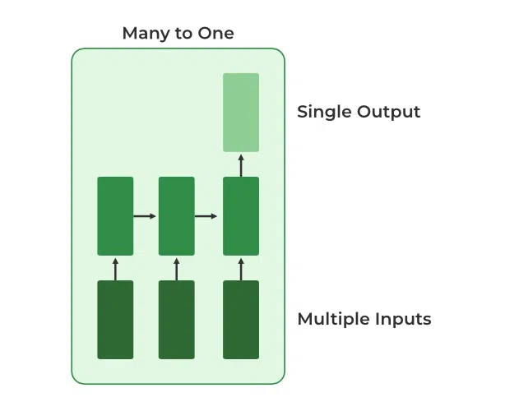
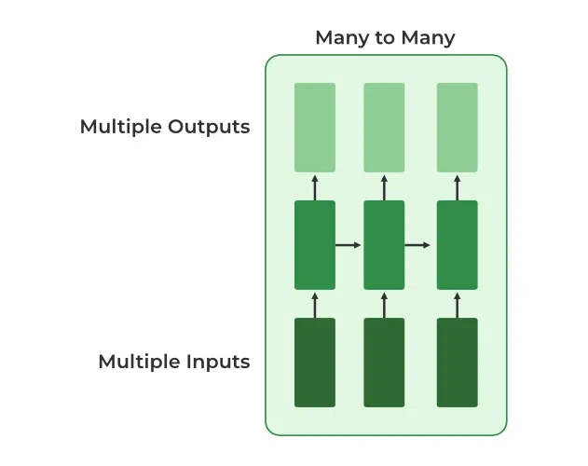
Many to One
Many to Many

Slide 16
Uses Of RNN
Natural Language Processing
Handwriting Recognition
Speech Recognition
Time Series Analysis

Slide 17
LSTM (Long Short-Term Memory)
LSTM is a type of neural network architecture that can remember and use information over long sequences.
It achieves this by having a special memory cell and gates that control the flow of information.
The gates decide what to remember, forget, and output from the memory cell, allowing the LSTM to capture long-term dependencies in sequential data.

Slide 18
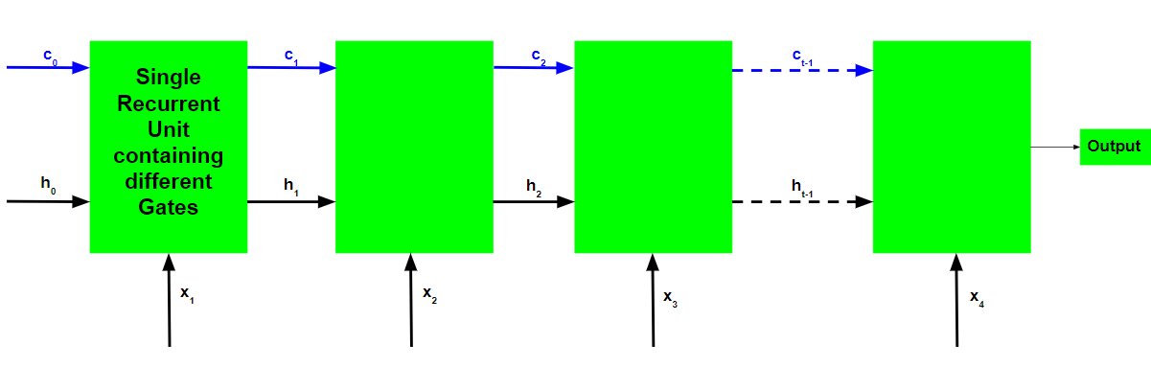
LSTM

Slide 19
Types of gates
Forget Gate(f)
Input Gate(i)
Input Modulation Gate(g)
Output Gate(o)

Slide 20
Uses Of LSTM
Healthcare
Music Composition
Activity Recognition
Gesture Recognition

Slide 21
Thank You

